Slide 1
Clickbait Detection
By Pied Piper
Pratik Sanjay Patil, 11840850
Thummala Milind Kesar, 11841160

Slide 2
Introduction
Use clickbait to increase views and get more exposure
Article writers (blogs, news)
Misleading title, Latest trends
Video creators (YouTube)
Thumbnail showing false/edited images
Irrelevant thumbnails

Slide 3
Objective
Problem 1 (Articles)
Given the title of an article, we need to detect if it is a clickbait or not.
Dataset-1
Problem 2 (YouTube Videos)
Given the title and thumbnail of a YouTube video, we need to detect if it is a clickbait or not.
Dataset-2

Slide 4
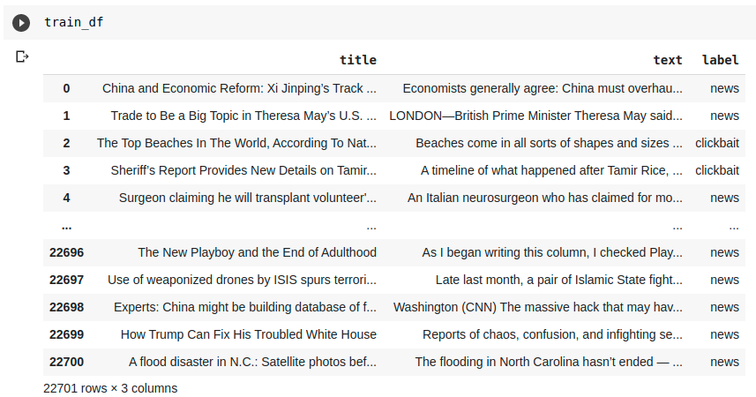
Dataset-1

Slide 5
Preprocessing
Assigned clickbait entry as 1 and non-clickbait entry as 0
Appended this column to the dataframe (label_int)

Slide 6
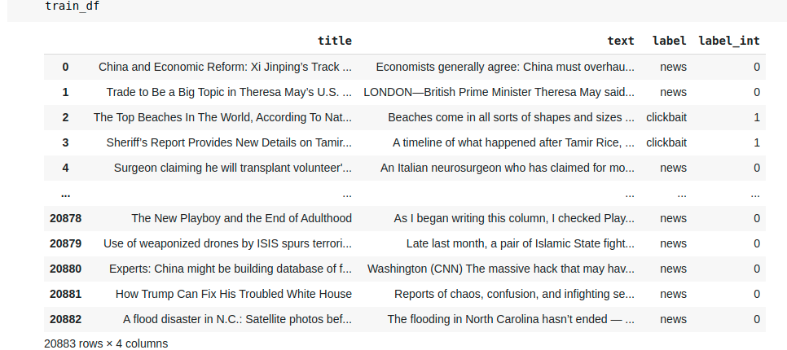
Dataset-1 (after Preprocessing)

Slide 7
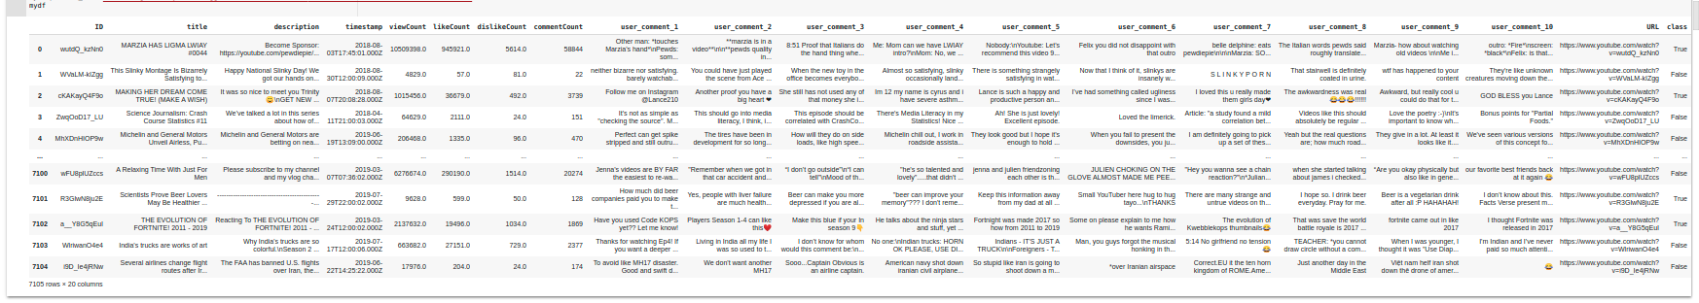

Dataset-2
ID: “-0Hzumchy68”
Important Columns:
ID - Unique Thumbnail ID
Title - title of the video
Class - Clickbait or not
Remaining Columns:
Timestamp
Likes/dislikes, views, comments count
Top comments

Slide 8
Preprocessing
As we only see the thumbnail and the title of the video
Just kept the title and thumbnail column
Assigned clickbait entry as 1 and non-clickbait entry as 0
Appended this column to the dataframe (_class)

Slide 9
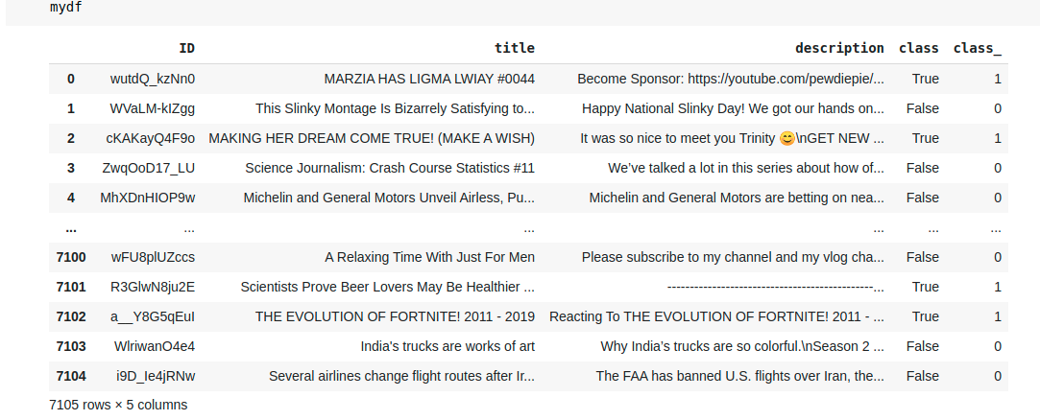
Dataset-2 (after Preprocessing)

Slide 10
Methodology
Our approach is based on Transfer Learning
We treat it as a classification problem where we would like to classify whether the given input is clickbait or not.
We finetune pretrained models such as BERT, ResNet which have been trained on large datasets by adding a couple of layers on top of these models for our task.
Hence instead of a random start we start of with the weights of such pretrained models and modify it a little to solve our problem

Slide 11
ClickBait Detection using only Headline
We use pre-trained BERT model for this and finetune it for our task.
We tokenize our input and pass it into pretrained BERT model which generates outputs of all the tokens.
The output of BERT model for a special token ([CLS]) represents the feature vector of the headline and we use this as input to our next layer.
We add a hidden layer on top of this and an output layer of size 2, since our task is similar to a binary classification problem.
This allows us to transfer the learning of the pretrained BERT model and we finetune it for our task.

Slide 12
Clickbait detection for Videos
We are given thumbnail of the video and the title and we have to decide whether it is clickbait.
Our methodology is similar to before. We use pre-trained BERT model for feature extraction of the title and pre-trained ResNet 18 model for feature extraction of the thumbnail. The penultimate layers of ResNet 18 model represent the feature vector of the image.
We concatenate these features from both the models as our combined feature and use this as input to a simple neural network architecture with a single hidden layer of size 512 and an output layer.
Then we finetune the weights for our task.
This is an end to end architecture.

Slide 13
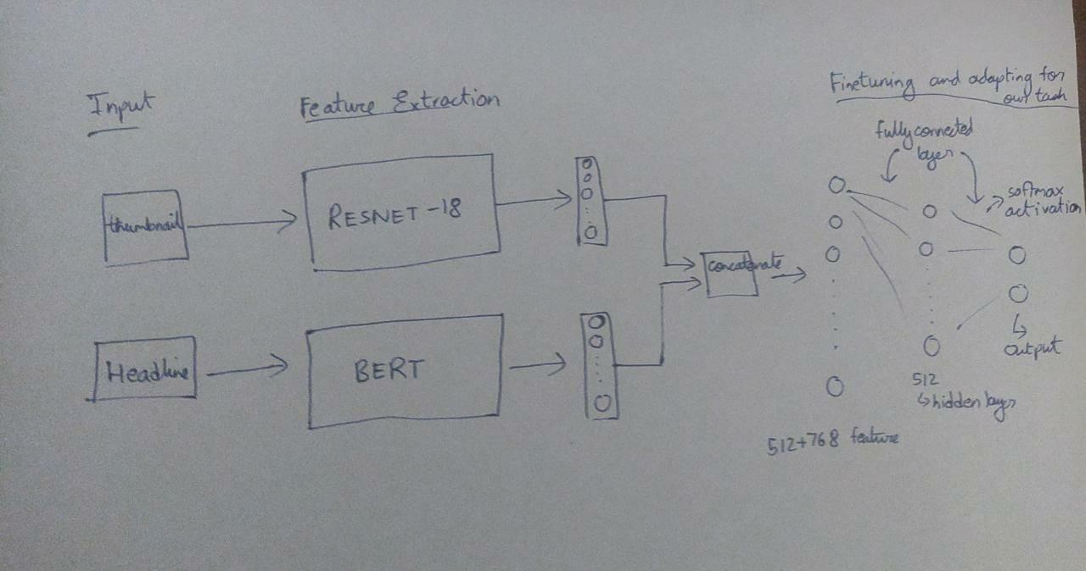
Our Architecture

Slide 14
Implementation - Fine-tuning
Train the entire architecture – We train the entire pre-trained model on our dataset and feed the output to a softmax layer. In this case, the error is back-propagated through the entire architecture and the pre-trained weights of the model are updated based on the new dataset.
Train some layers while freezing others – Another way to use a pre-trained model is to train it partially. What we can do is keep the weights of initial layers of the model frozen while we retrain only the higher layers. We can try and test as to how many layers to be frozen and how many to be trained.
Freeze the entire architecture – We can even freeze all the layers of the pre-trained model and attach a few neural network layers of our own and update the weights of only these layers. Hence the weights of only the attached layers will be updated during model training.
We found that for our case freezing the entire architecture gave best results because these pretrained models have many parameters and tend to overfit on smaller datasets.

Slide 15
Implementation - Other Details
We used cross entropy loss and AdamW optimizer. We found the optimum learning rate to be 2x10⁻⁵ for both using only headline as well as for clickbait for videos.
We used dropout for regularization.
For using only headline to detect clickbait, we used 70% for training, 15% for testing and 15% for validation. For this there was a bias in class distribution and we accounted for this by giving class weights as input to loss function.
For clickbait detection on videos we used 80% for training, 10% for testing and 10% for validation. We also performed some preprocessing on images such as normalizing and scaling it down.

Slide 16
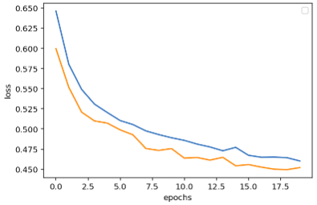
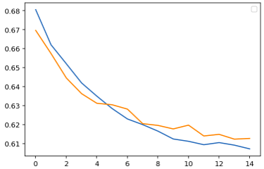
Loss Curves
The loss curves for clickbait detection in case of videos (left) and clickbait detection using only headline (right) are as shown. Orange represents validation loss and blue represents training loss.

Slide 17
Results
ClickBait Detection for videos:
Clickbait detection using only headline (for dataset-1):
In this case we got an accuracy of 0.73 and weighted average F1-score of 0.74
 | Accuracy | Weighted Avg f1-score
Only thumbnail | 0.8 | 0.79-0.8
Only headline | 0.78 | 0.78
Our approach | 0.85 | 0.85

Slide 18

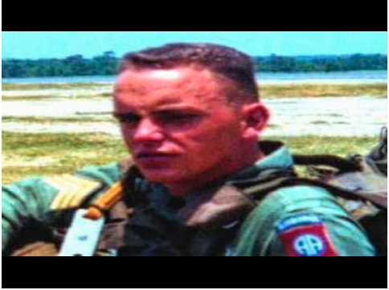
Sample Predictions of our Model
Examples of two clickbait video correctly detected by our model.
Title : “You Laugh = You're a Gamer” Title: “Man Found In Vietnam Jungle After 40 Years Stuns Police”

Slide 19
Conclusion
We have built models to detect clickbait for videos where we are given the thumbnail and title and also to detect clickbait when we are given headline of any article.
We have shown that our model achieves better performance for clickbait in video detection by combining both thumbnail and title.
We have achieved good results for clickbait detection which is a very common problem encountered in our day to day lives.

Slide 20

Thank You!

